Slide 1
Mini-Web Agent for Choosing the Right Products
University of Technology (Yatanapon Cyber City) Faculty of Information and Communication Technology Department of Information Science
Title Defense
By
Thaw De Zin (6IST-66)
February 1, 2019

Slide 2
Outline
Introduction
Abstract
Objectives
Scope of Thesis
Field Background
System Design
Expected Output
Future work
Conclusion

Slide 3
Introduction
Web scraping is an automated tool for finding and extracting data from on-line sources.
Web scraping is also referred to as automated data collection, web extracting, web crawling, or web content mining.
Web scrapers can go places that traditional search engines cannot.
Web scraping commonly used in price comparison, president election, brand promoting and miscellaneous purposes.

Slide 4
Abstract
The proposed system is aimed to help people in finding their products.
This system is to develop web agent for people to choose which products they should buy.
The system will take user input about product and send crawlers to get information about products across the web resources.
Then, extract the matched data, store, organized and show it.
This system will be developed using Web Scraping.

Slide 5
Objectives
To develop simple web scraping tool
To understand how a crawler; bot works
To know web scraping use cases and applied areas
To study how search engine works
To collect data for web mining

Slide 6
Scope of Thesis
This system is limited with maximum of 3 websites for crawling.
Frequently changed layout of website will not be processed.
The working product is only specific one. (Example., Laptops)

Slide 7
Field Backgrounds
Web Scraping is also known as Web data mining or web harvesting.
Process of building a bot which can parse, extract, download and organize useful information from the web automatically.
In a nutshell, web scraping is the process of extracting data from websites.
All the job is carried out by a piece of code which is the combination of a “crawler” and “scraper”.
First, it sends a “GET” query to a specific website.
Then, it parses an HTML document based on the received result.
After it’s done, the scraper searches for the data you need within the document, and, finally, converts it into the specified format.

Slide 8
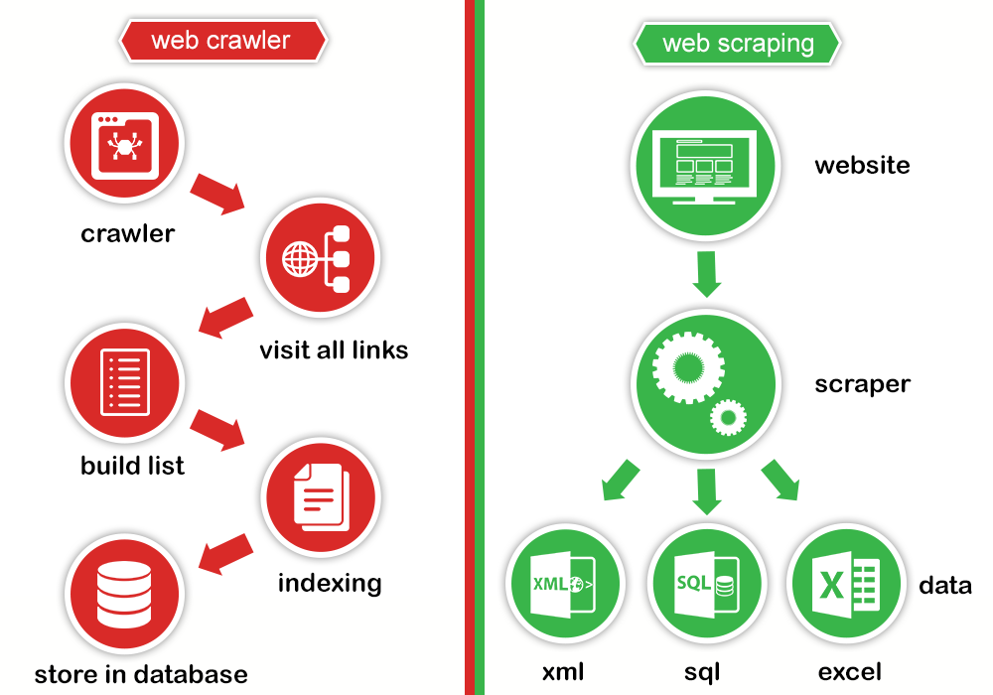
Field Backgrounds (Cont’d)

Slide 9
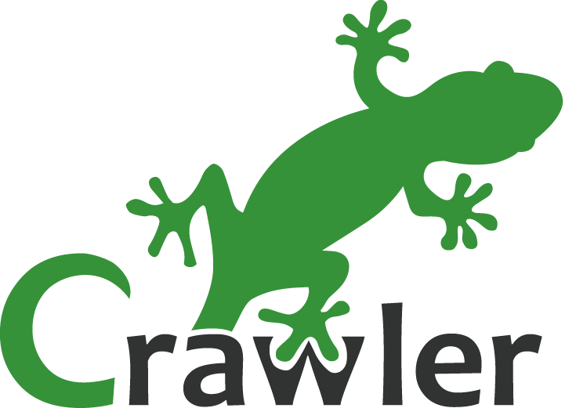
Web Crawlers
The major search engines on the Web all have such a program, which is also known as a "spider" or a "bot."
Crawlers consume resources on visited systems and often visit sites without approval.
A crawler is a program that visits Web sites and reads their pages and other information in order to create entries for a search index.
Crawlers are typically programmed to visit sites that have been submitted by their owners as new or updated.
Entire sites or specific pages can be selectively visited and indexed.
Crawlers apparently gained the name because they crawl through a site a page at a time, following the links to other pages on the site until all pages have been read.

Slide 10
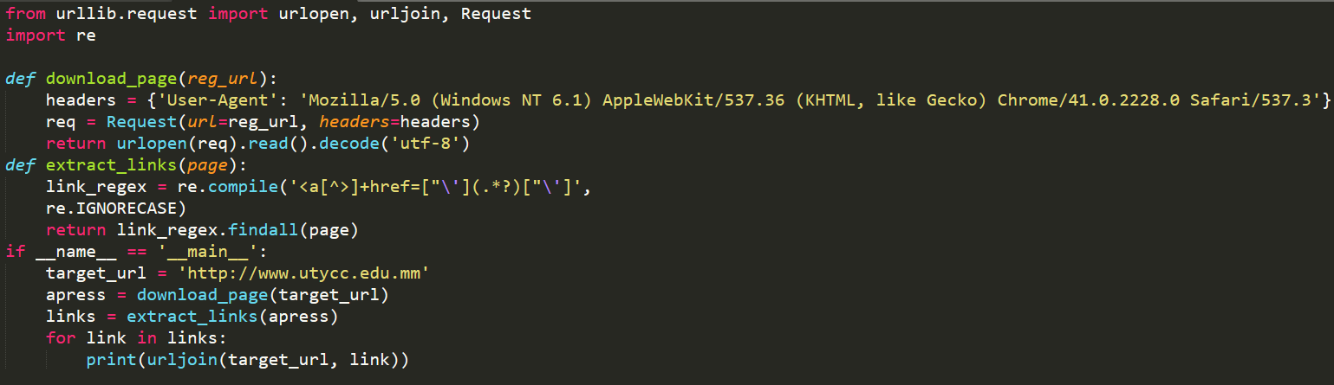
Sample Python program for Link Finding

Slide 11
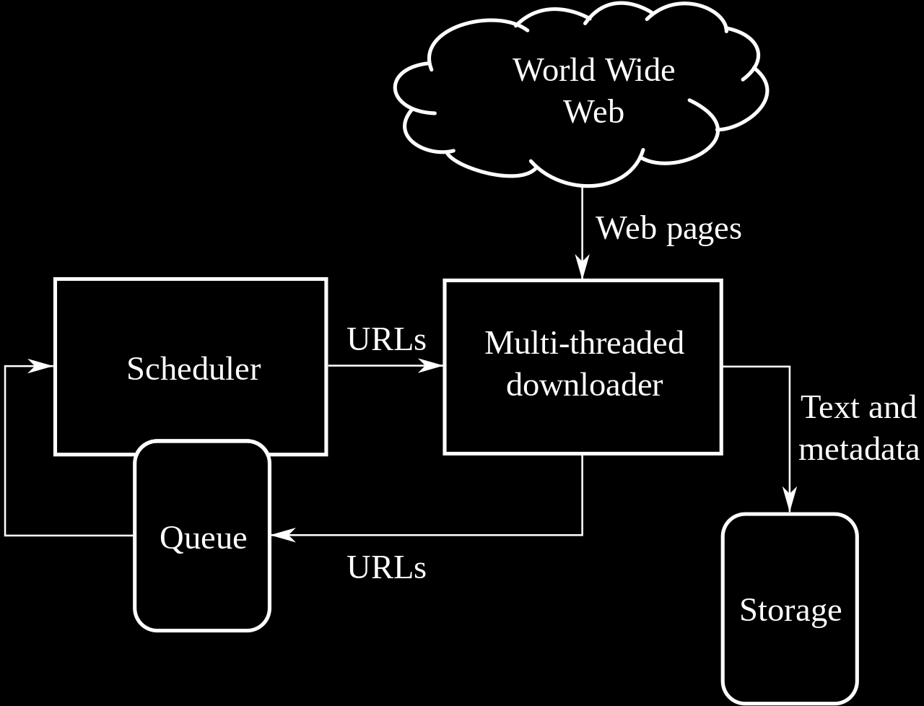
High-level architecture of a standard Web crawler

Slide 12
How Web Scraping working structure
Web scraping is mostly use tree data structure as its processing.
A tree is an undirected graph in which any two vertices are connected by exactly one simple path.
Any connected graph without simple cycles is a tree.
A tree data structure simulates a hierarchical tree structure with a set of linked nodes.
A hierarchy consists of an order defined on a set. The term hierarchy is used to stress a hierarchical relation among the elements

Slide 13
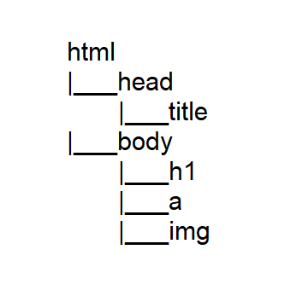
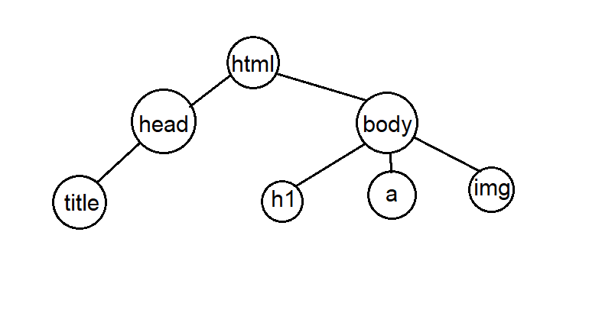
How HTML is assumed as tree structure

Slide 14
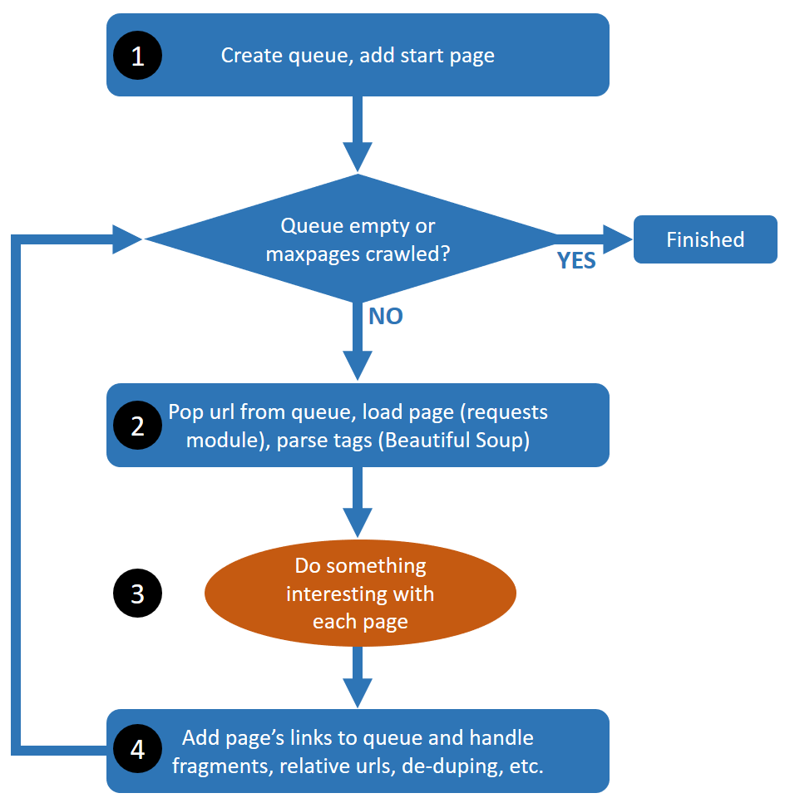
How Web Scraping works

Slide 15
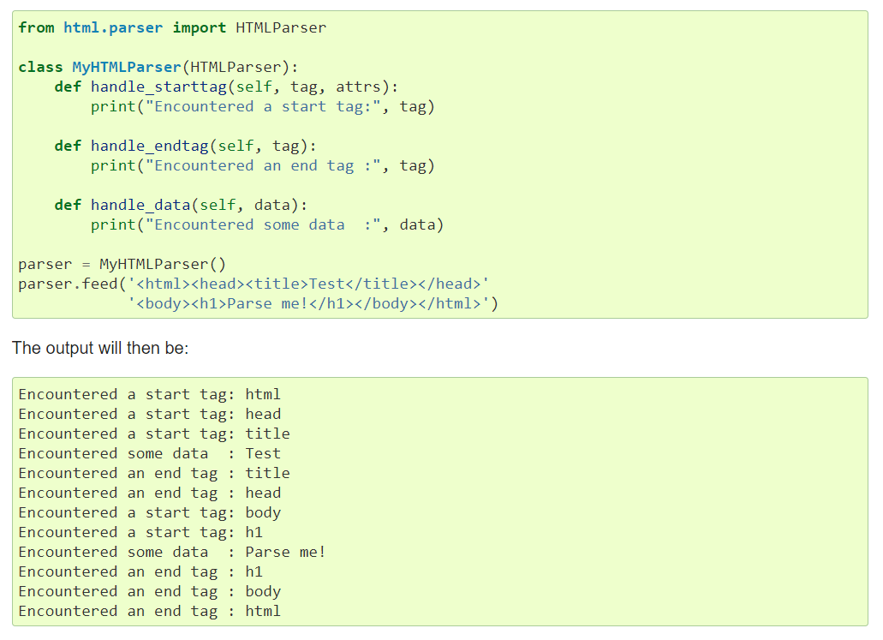
Simple Python Application for HTML Parsing

Slide 16
Advantages of Web Scraping
Need for mining data for building machine learning models
Monitor price wars
Stock Market Tracking
Brand Monitoring
Service Providers
Data Augmentation
Business Information

Slide 17
Limitations & Awareness
Bots can be blocked by monitoring excess traffic or a CAPTCHA.
Commercial anti-bot services.
A honeypot or other method to identify the IP addresses of automated crawlers.
Websites can declare if crawling is allowed or not in the robots.txt file
Bot Trap

Slide 18
System Design
Download
Crawl and download the requested contents
Extract
The data on websites is HTML and mostly unstructured
parse and extract structured data
Store
Analyze
Store and save the extracted data
CSV, JSON or in database
Examine the data

Slide 19
System Flow
Start
Type, Spec & Price
Crawl to search
Storage
Scraper to extract and Fetch
Suitable Product
End

Slide 20
Tools & Framework
Request (Standard Library)
Scrapy Framework
Beautiful Soup (Version 4)
Selenium

Slide 21
User Input Limitations
Specification
Price
Brand
Available format!
S+B
S+P
B+S
B+P
P+S
P+B
B+S+P is not available

Slide 22
Expected Output
This system will be a website or a GUI tool.
The result will show that where and how the desire product is located.

Slide 23
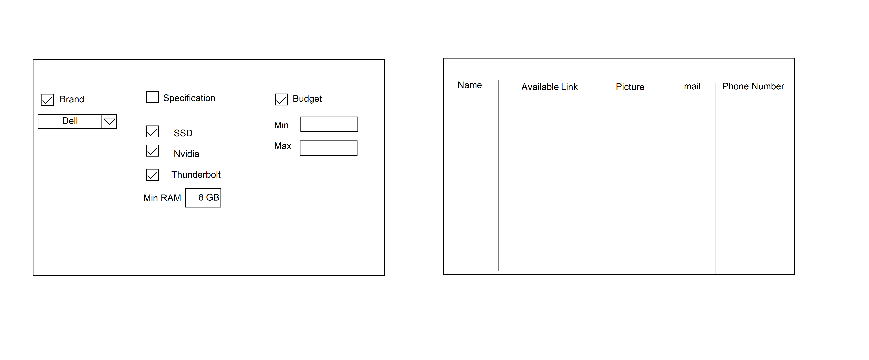
Expected Output (Cont’d)
Fig. expected output (Draft)

Slide 24
Future Work
Construct website or tool (70% complete)
Crawling the desired product (50% complete)
Scraping the required information about product

Slide 25
Conclusion
This system will give to much knowledge about web scraping and web crawlers.
The user can get the information about the suitable product.
By studying this system, you will get knowledge about that there are so many applicable use cases with Web Scraping.

Slide 26
Thank you for your discussion and attention!

